Slide 1


Slide 2
Project
PRESENTATION

Slide 3

VU Proctors-Diary

Slide 4
Group Members Introduction
Mehak (BC230410624)

Slide 5
INTRODUCTION OF PROJECT
The “VU Proctors Diary” is a web-based application that aims to modernize the exam monitoring and reporting process for Virtual University proctors by replacing traditional physical diaries with a digital system. The current manual approach is inefficient, vulnerable to data loss, and lacks centralized access. The proposed online platform will enable proctors to log in securely and perform tasks in real-time, including attendance tracking, incident reporting, and observation submission, thereby streamlining the entire process.
The system will also facilitate communication between proctors and examination authorities, allowing timely reporting and quick action in case of exam violations. Features such as duty schedules, automated report generation, and data retrieval will enhance the efficiency and transparency of the examination process. The centralized database will ensure that records are well-maintained, searchable, and accessible for future reference.
This project is especially relevant in the context of VU's widespread online and physical exam centers, where real-time data synchronization and management are crucial. By replacing manual diaries with a digital solution, the VU Proctors Diary will not only reduce paperwork but also improve the overall effectiveness of the examination
monitoring system

Slide 6
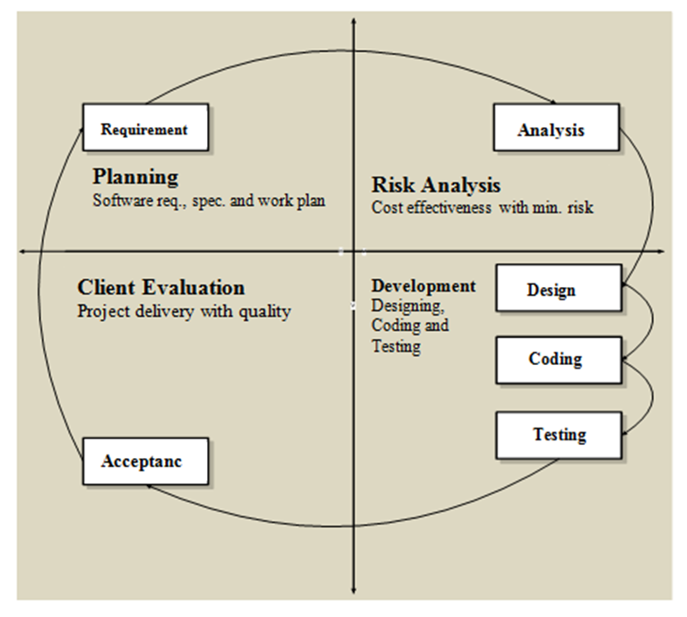
VU Process Model

Slide 7
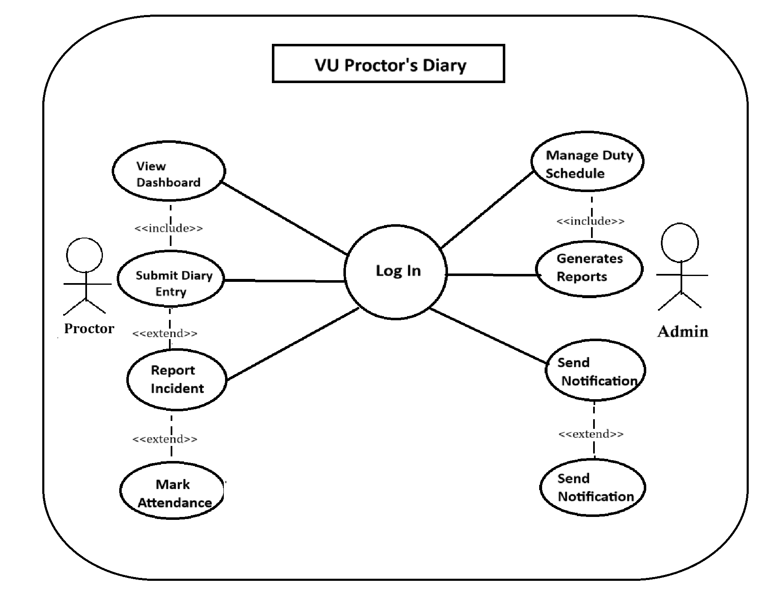
Use Case Diagram

Slide 8
INTRODUCTION OF PROJECT
1. Secure Login: Proctors and admins can log in with verified credentials.
2. Personalized Dashboard: Proctors access a dashboard with assigned tasks and exam information after logging in.
3. Schedule Management: Admins can create and update proctoring schedules.
4. Daily Reporting: Proctors submit daily reports and observations about exams.
5. Incident Reporting: Proctors report any irregularities during exams.
6. Attendance Tracking: Proctors record their attendance and students' attendance.
7. Notification System: Alerts and updates are sent between proctors and admins.
8. Report Generation: Admins generate and download proctor activity summaries.
9. Search Functionality: Users search previous entries by date, proctor, or exam center.
10. Role-Based Access: Different permissions for Admin and Proctor roles.

Slide 9
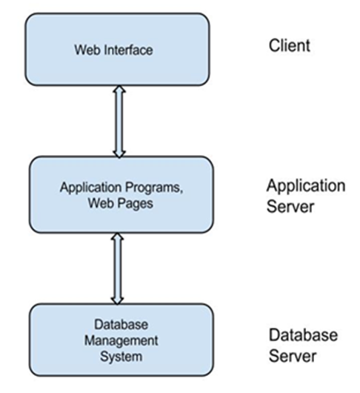
Architectural Design

Slide 10
Team Structure
Supervisor: Tooba Ahmad
Student: Mehak

Slide 11
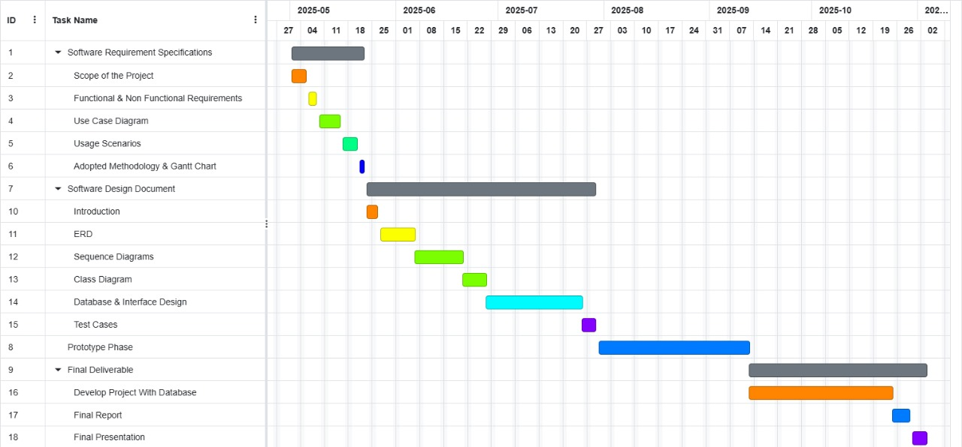
Project Schedule

Slide 12
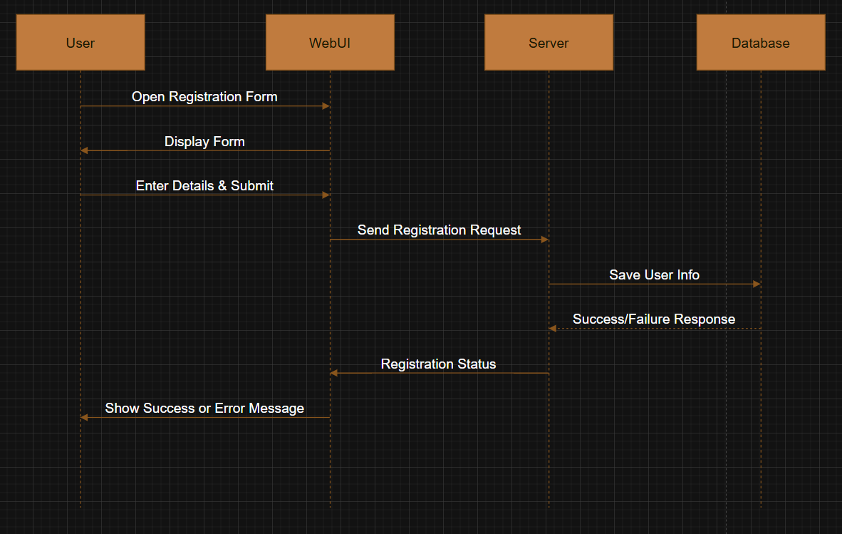
Sequence Diagrams
REGISTER:
.

Slide 13
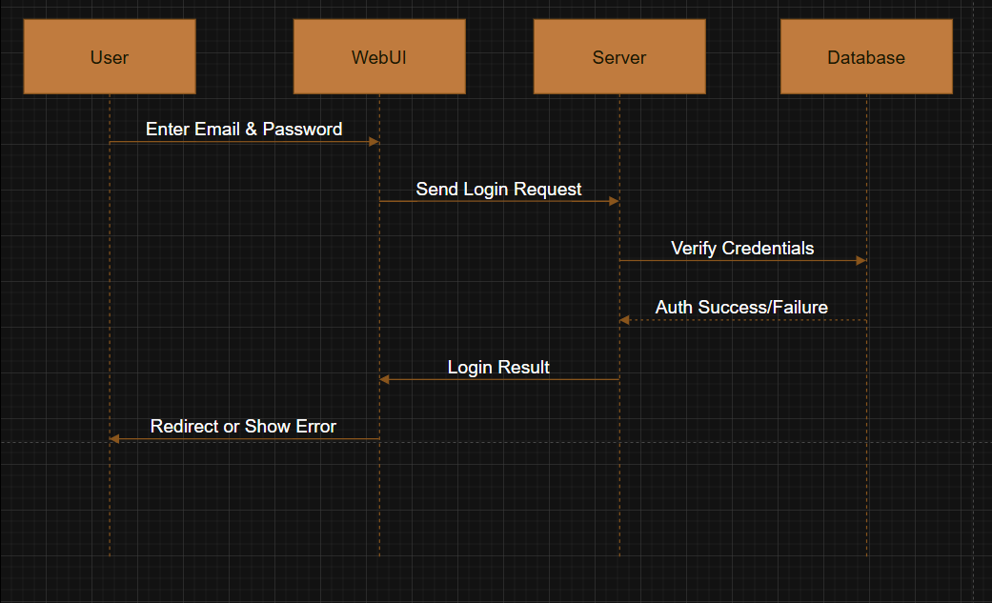
Sequence Diagrams
LOGIN:
.

Slide 14
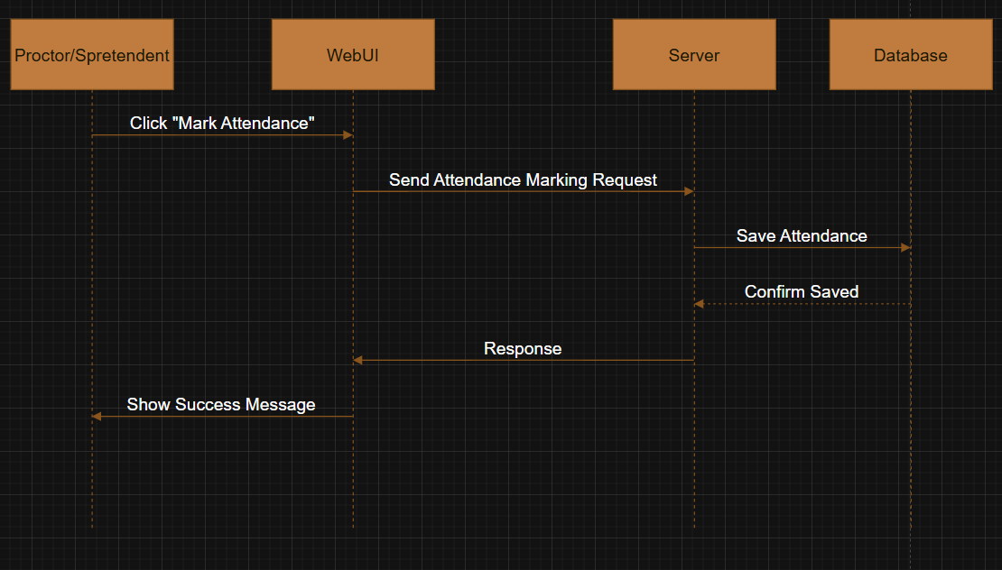
Sequence Diagrams
Mark Attendance:
.

Slide 15
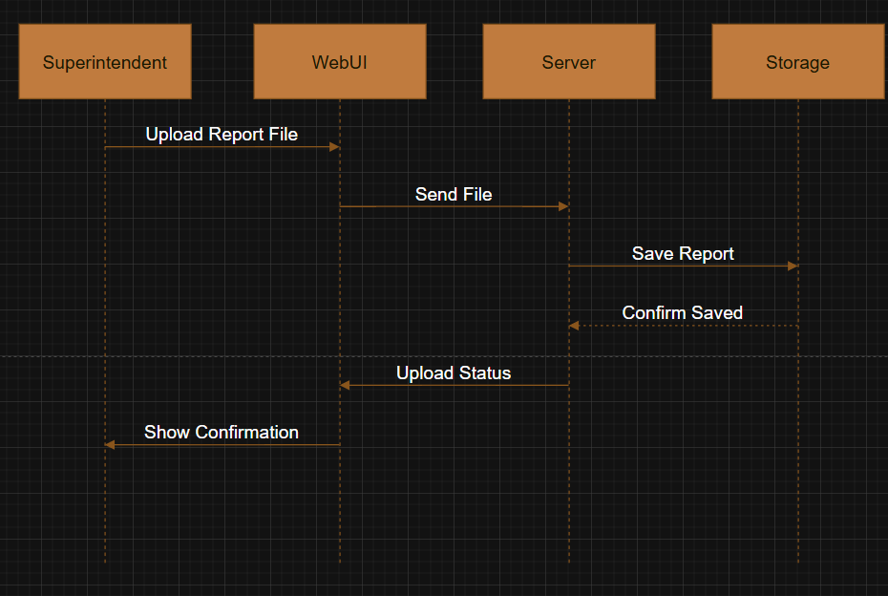
Sequence Diagrams
Upload Report
.

Slide 16
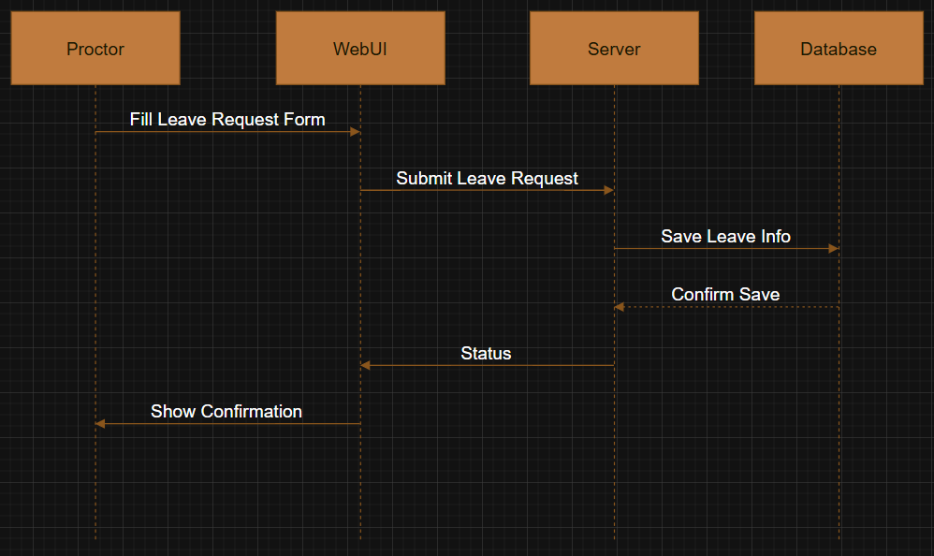
Sequence Diagrams
Leave Request
.

Slide 17
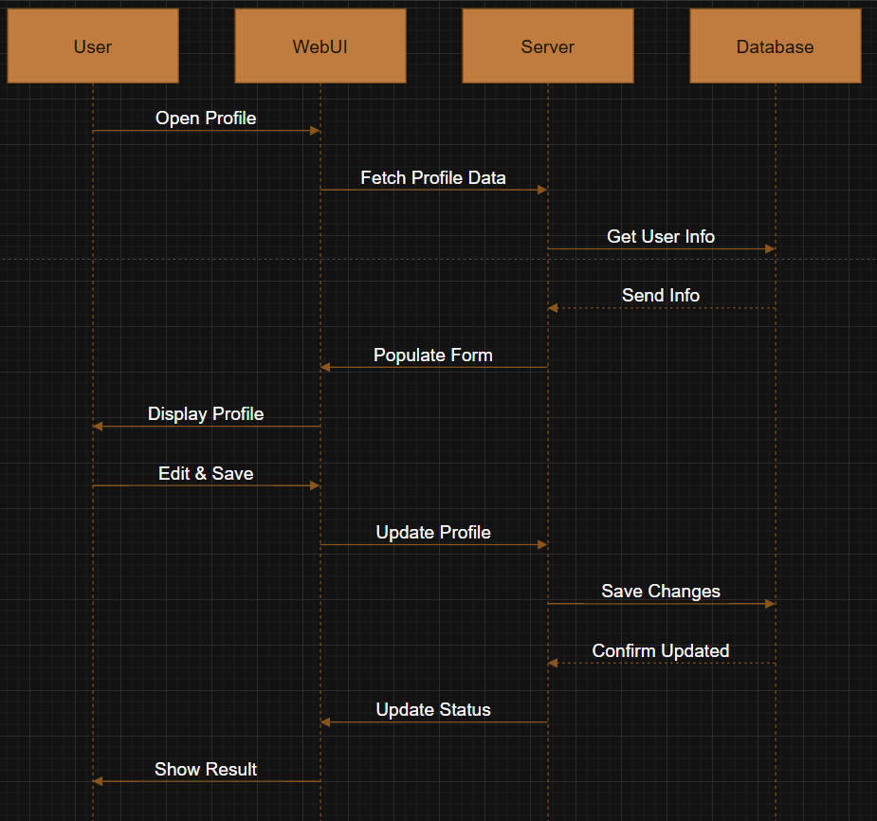
Sequence Diagrams
Update Profile:
.

Slide 18
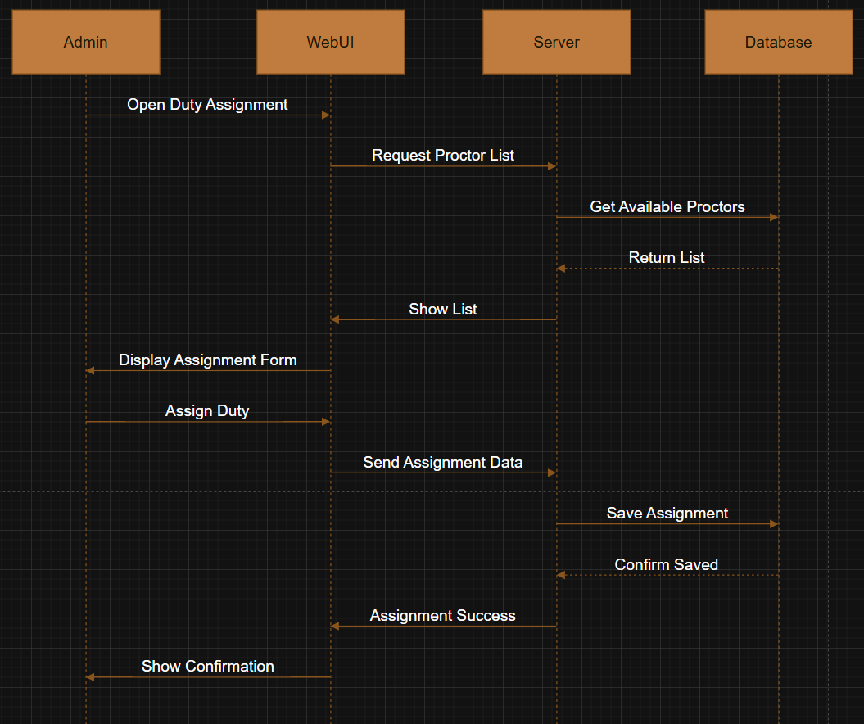
Sequence Diagrams
Duty Assignment:
.

Slide 19
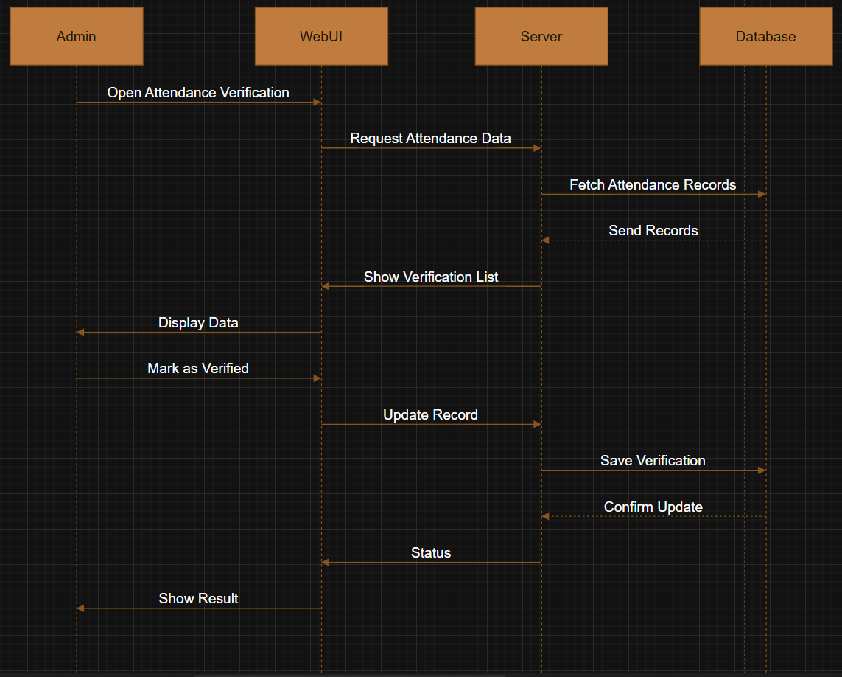
Sequence Diagrams
Manage Attendance:
.

Slide 20
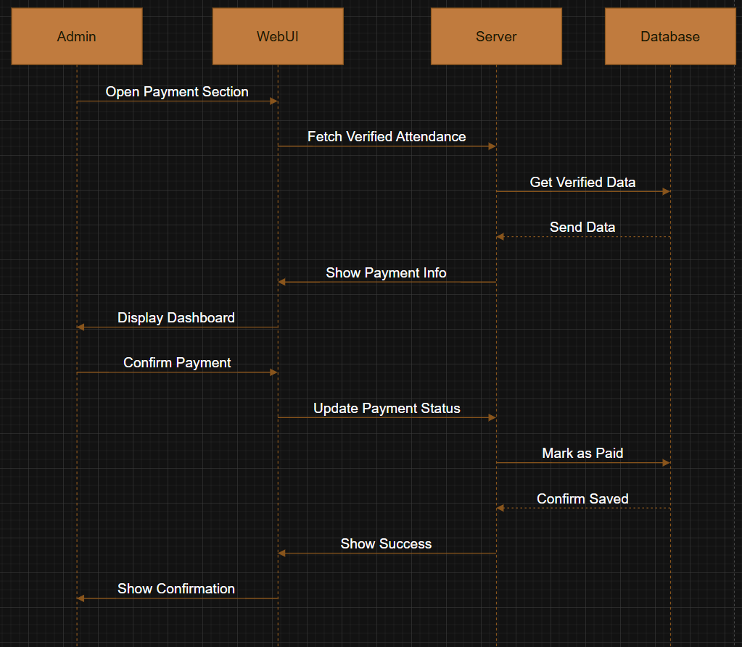
Sequence Diagrams
9: make payment:
.

Slide 21
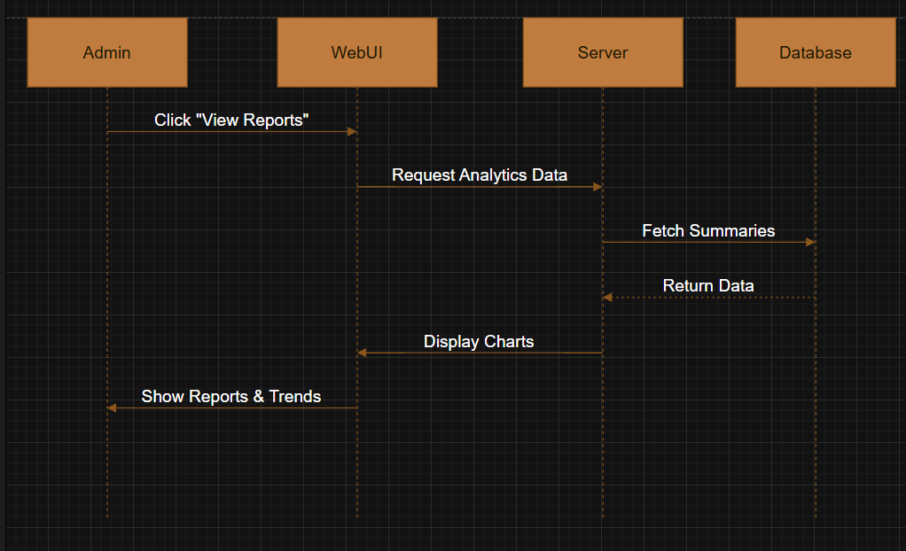
Sequence Diagrams
10: manage reports
.

Slide 22
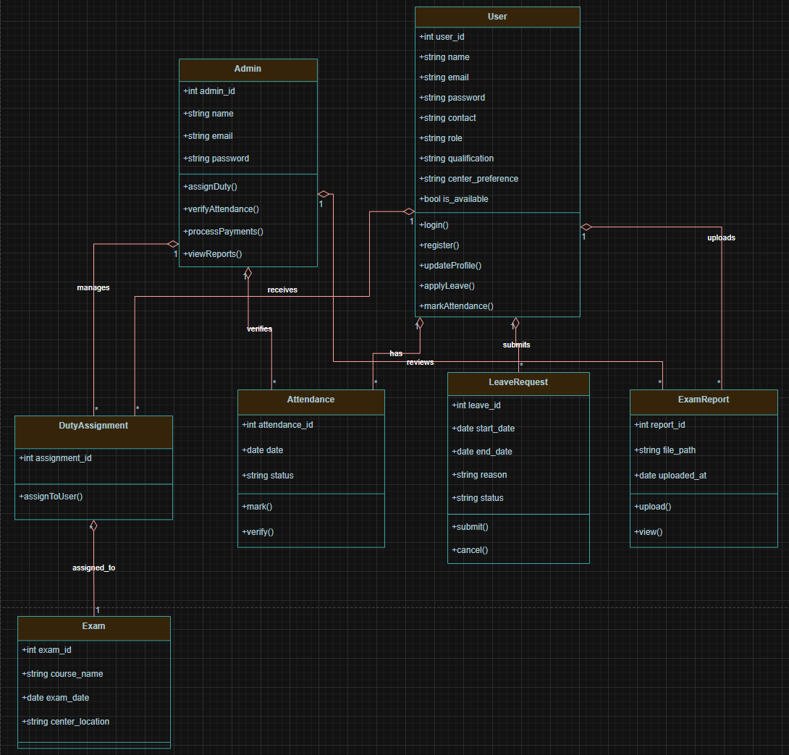
Logical Model/Class Diagram

Slide 23
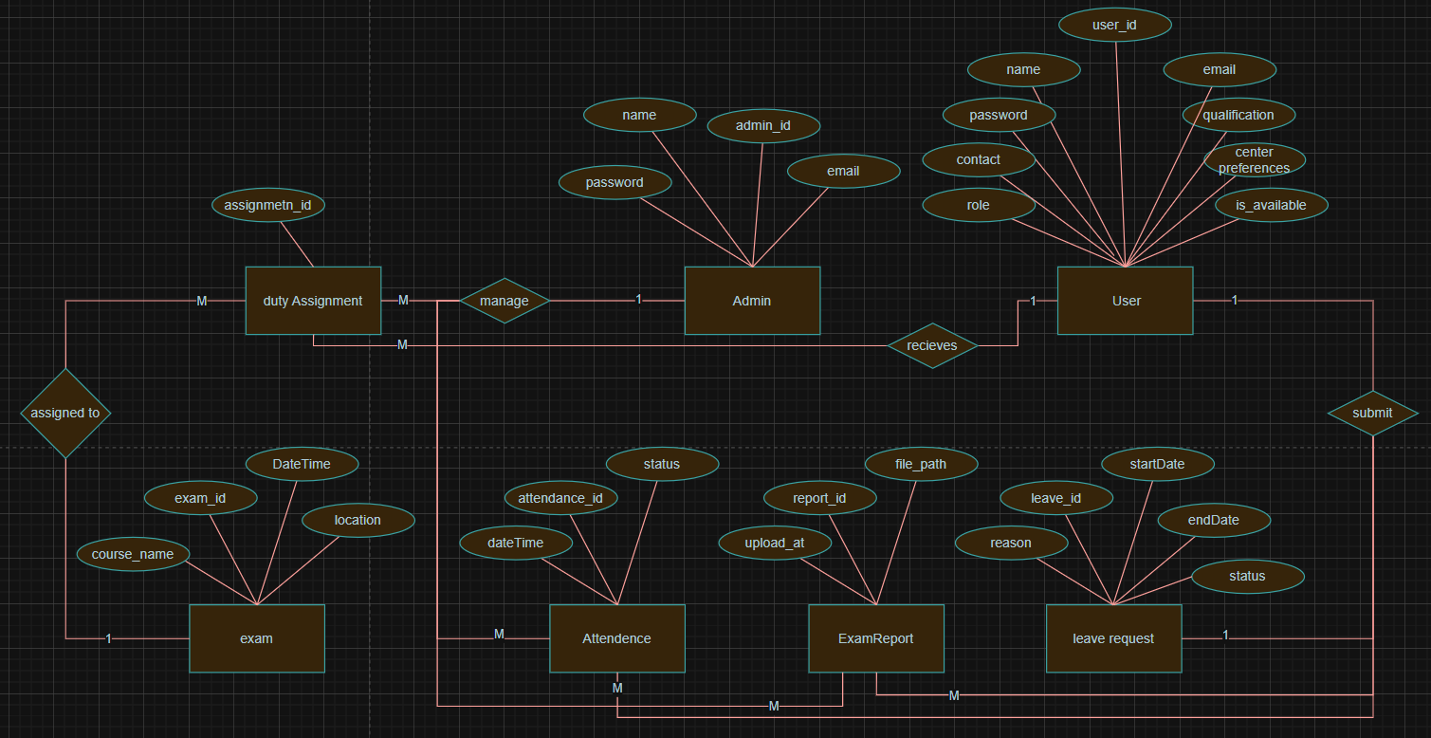
Entity-Relationship Diagram

Slide 24
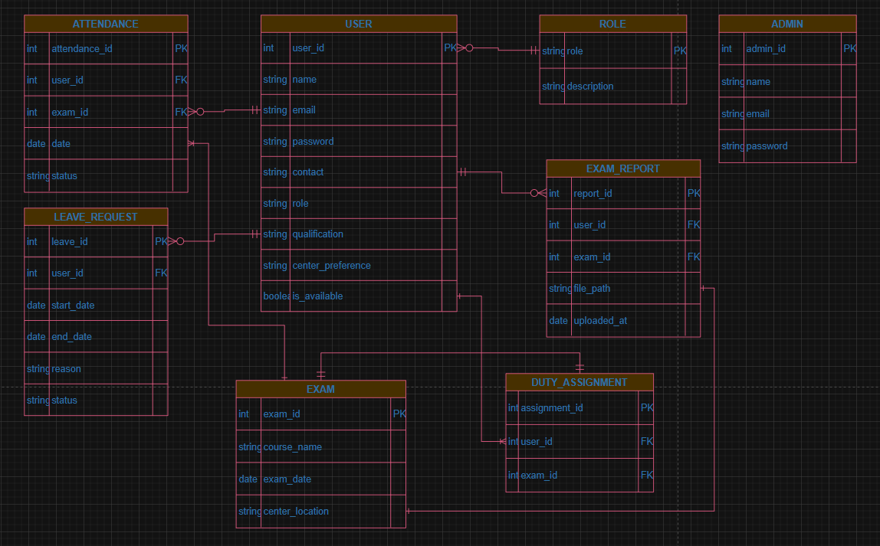
Database Diagram

Slide 25
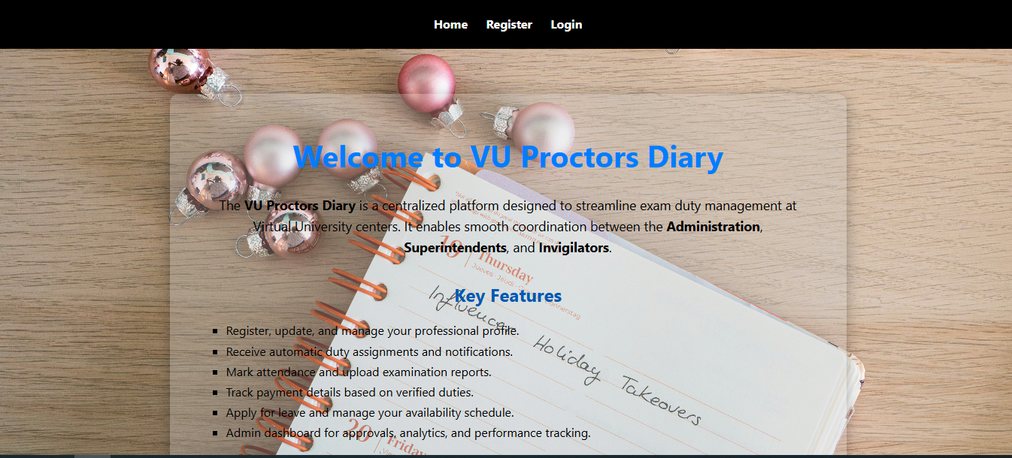
User Interfaces

Slide 26
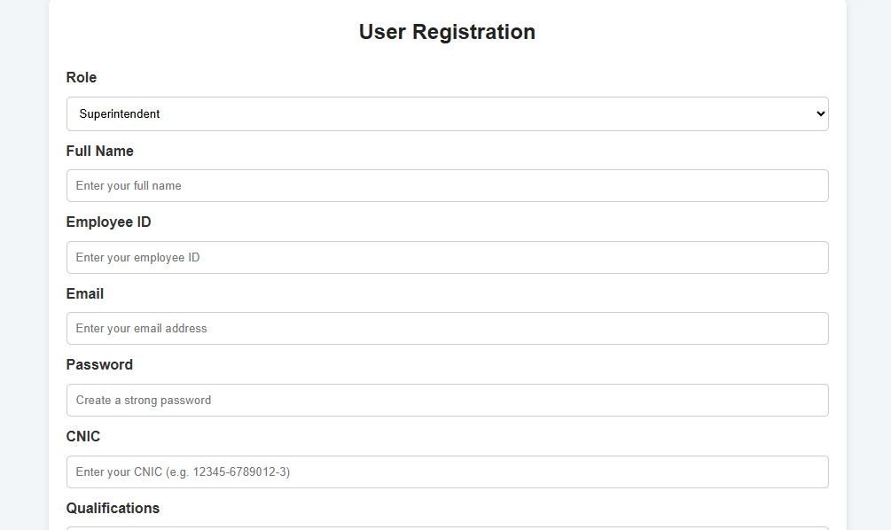
User Interfaces

Slide 27
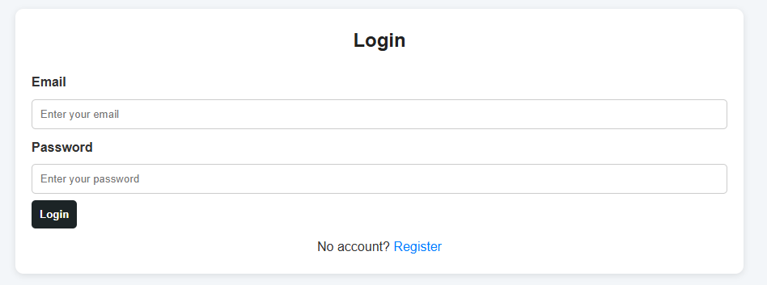
User Interfaces

Slide 28
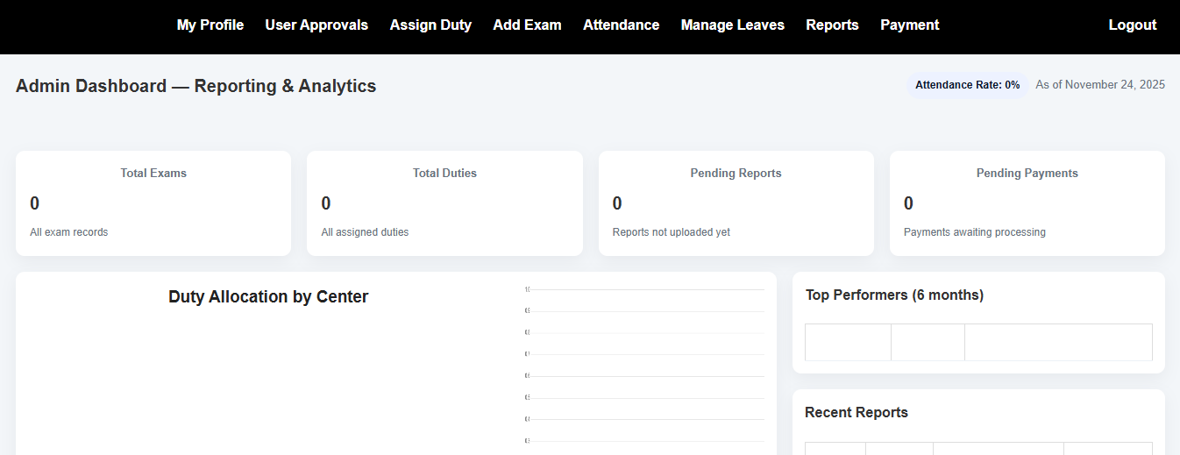
User Interfaces

Slide 29
Tools
Languages: HTML, CSS, PHP
Database Tool: Sqllite
Other Tools: Microsoft Office (Word, Visio, PowerPoint, MS Project) + VS Code

Slide 30
THANKS

